Slide 1

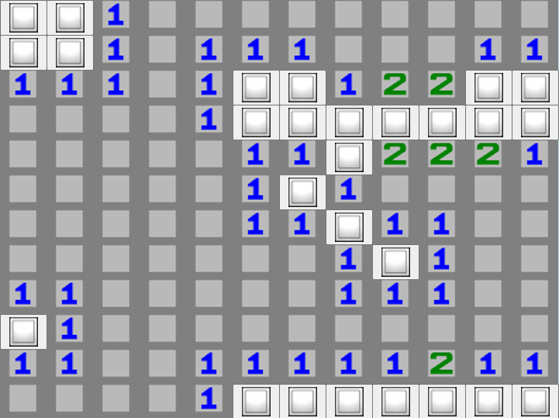
CST-247 CLC Milestone
MineSweeper Application
Cameron Deao
Vinson Martin
Joseph Cooper

Slide 2
Agenda
Minesweeper Functionality
Registration & Login
Play Minesweeper Game
Save Stats & View High scores
Save & Retrieve Gameplay
Technical Design
Game Logic
MVC 5 Web Application & Scalability requirements
User Interface
SQL Database
Secure Game Site
GitHub URL
Logging
Issues & Challenges
AJAX web-based User Interface.
Demo
CST-247 CLC Milestone-MineSweeper Application

Slide 3
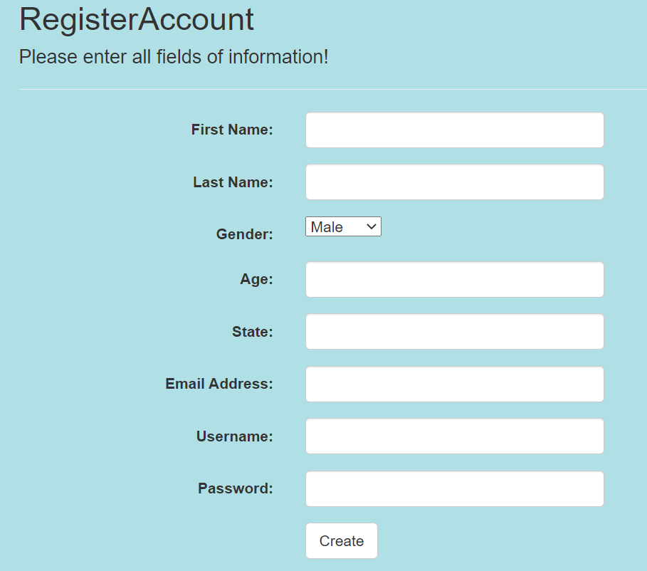
Minesweeper Functionality
Registration & Login
Users are able play a Minesweeper game without registering, however, user registration gives the user more functionality.
Registered user functionality:
Registered users game statistics are tracked.
Registered users have the ability to earn a high scores that are displayed for the home page for all users to see.
Registered users may save their game in the middle of a game and retrieve there save game state at a later time.
Registered user personal information is secure.
CST-247 CLC Milestone-MineSweeper Application

Slide 4

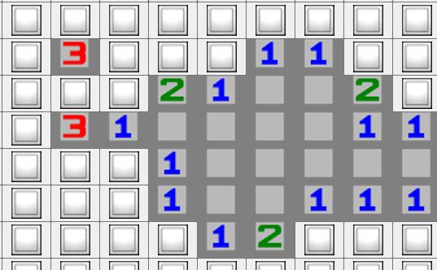
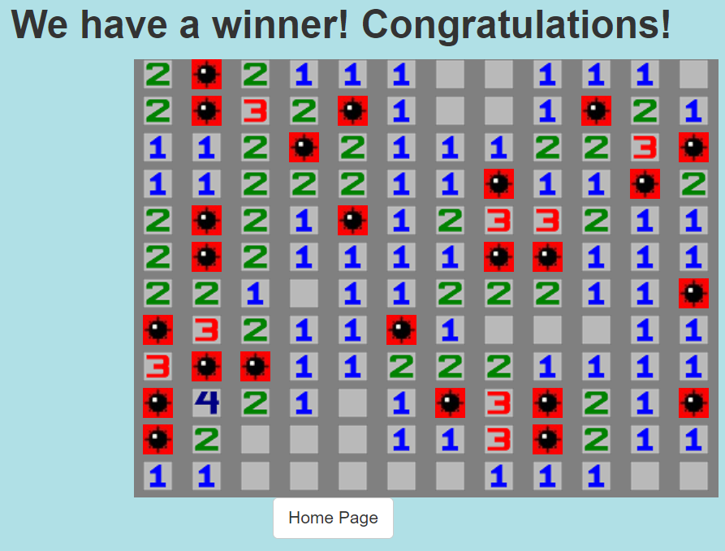
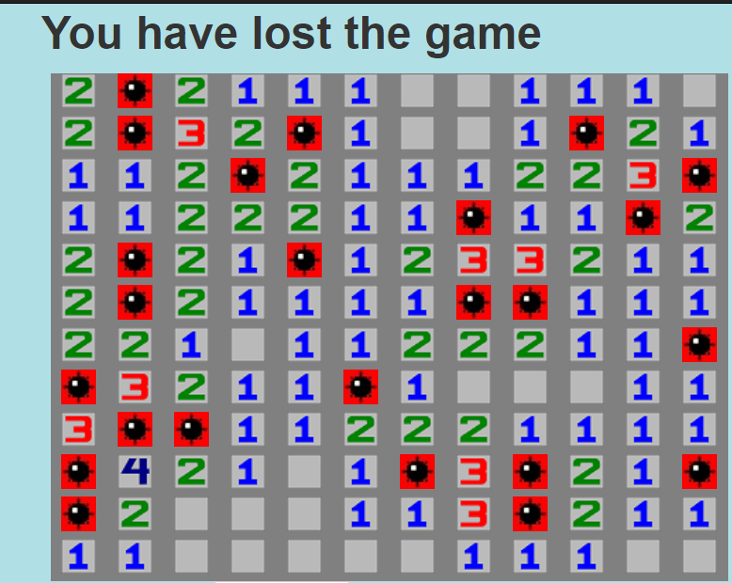
Minesweeper Functionality
Play Minesweeper Game
Users are able to experience a fully functional graphical web application version of Minesweeper.
The rules of the game:
Users must uncover the hidden empty cells by clicking on them.
The number on a block shows the number of mines adjacent to it.
Users have to avoid all the mines and uncover all of the hidden boxes that does not contain mines to win the game
If a user click on a mine, the user automatically loses.

Slide 5
Minesweeper Functionality
Save Stats & View High scores
CST-247 CLC Milestone-MineSweeper Application

Slide 6
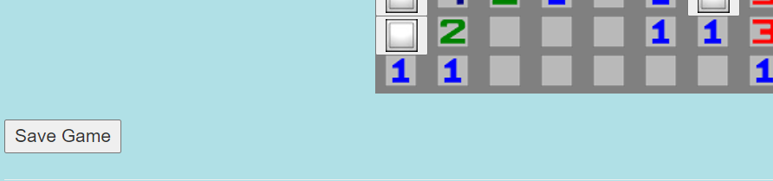
Minesweeper Functionality
Save & Retrieve Gameplay
Registered logged in users have the ability to save their game state in game.
After logging in, the game state can be loaded after logging in.
CST-247 CLC Milestone-MineSweeper Application

